Slide 1




AngularJS
Super Heroic JavaScript MVC Framework
SoftUni Team
Technical Trainers
Software University
http://softuni.bg

Slide 2

Who am I?
Vladimir Georgiev
Microsoft Certified Professional
Software Developer and Technical Trainer @ Software University
Top performing graduate from the Telerik Software Academy (2013)
Student in Technical University
Computer and Software Engineering
Web site & blog: www.VGeorgiev.org
Twitter: @VGeorgiew

Slide 3

AngularJS
Course Objectives & Program

Slide 4
AngularJS – Old Course Program
Course Introduction – course program, trainers, evaluation, resources
Introduction to AngularJS – overview, resources, simple application
Controllers and Markup – controllers, $scope object, markup, binding, filters, validation
Services – custom and built-in-services
Routing – using routes, templates, partial views
Directives – creating directives, attribute specifics, jQuery as directive
AngularJS Best Practices – organization, modules, dealing with scope…
Workshop – Building SPA with AngularJS (live demo)

Slide 5

AngularJS – New Course Program
Introduction to AngularJS
Course Introduction
Introduction to AngularJS
Controllers and Markup
AngularJS Components
Services in AngularJS
Routing in AngularJS
Directives in AngularJS
Best Practices
Angular Architecture
Best Practices with AngularJS

Slide 6
AngularJS – New Course Program (2)
Working with Data
Accessing data
Working with $http and $resource
CORS, OData…
Authentication and Authorization
Registration and Login
Data Validation
Unit Testing
Error handling
Unit Testing
Workshop

Slide 7

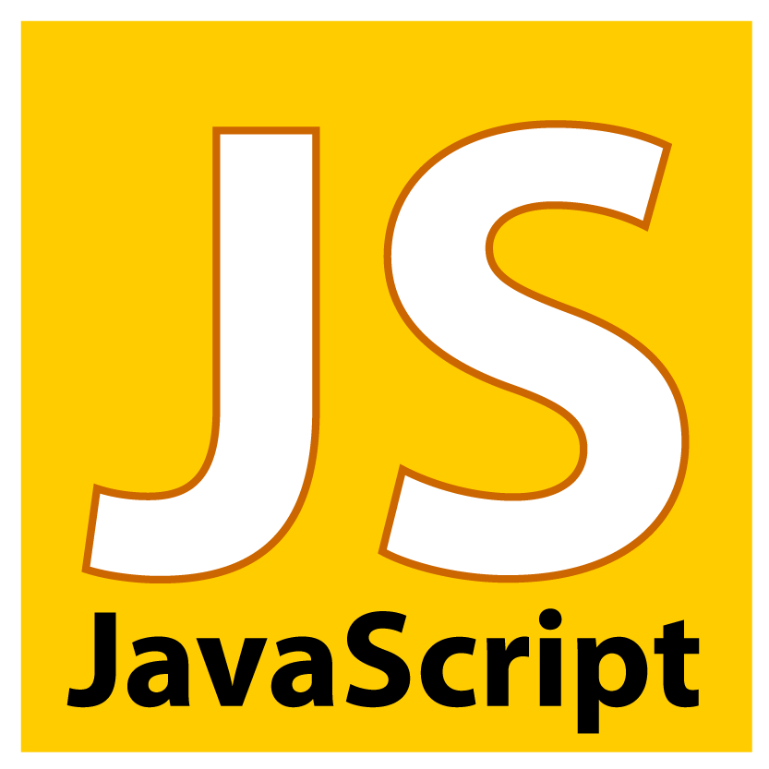
Warning: Not for Absolute Beginners
The “AngularJS" course is NOT for absolute beginners
Requirements
JavaScript coding skills – entry level
Computer English – entry level
Logical thinking
coding skills
required!

Slide 8
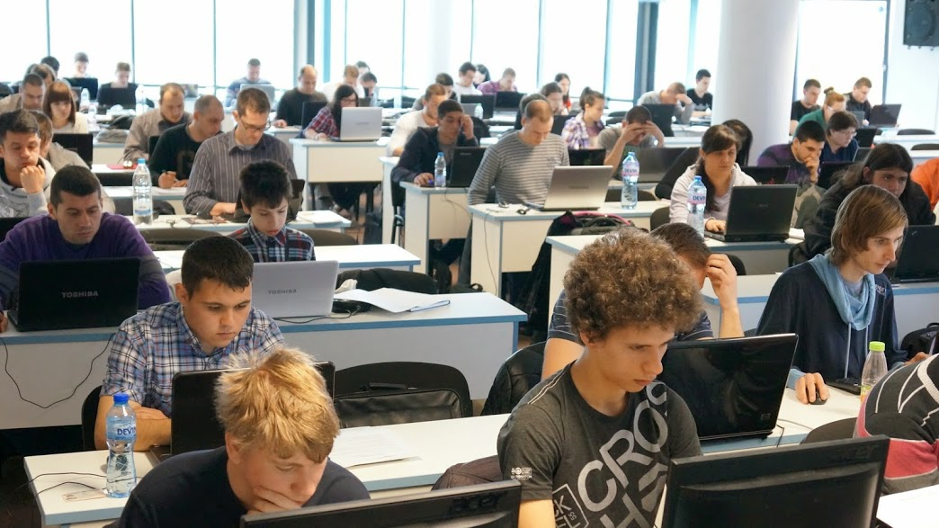
AngularJS: More Details
Duration, Languages, Technologies

Slide 9

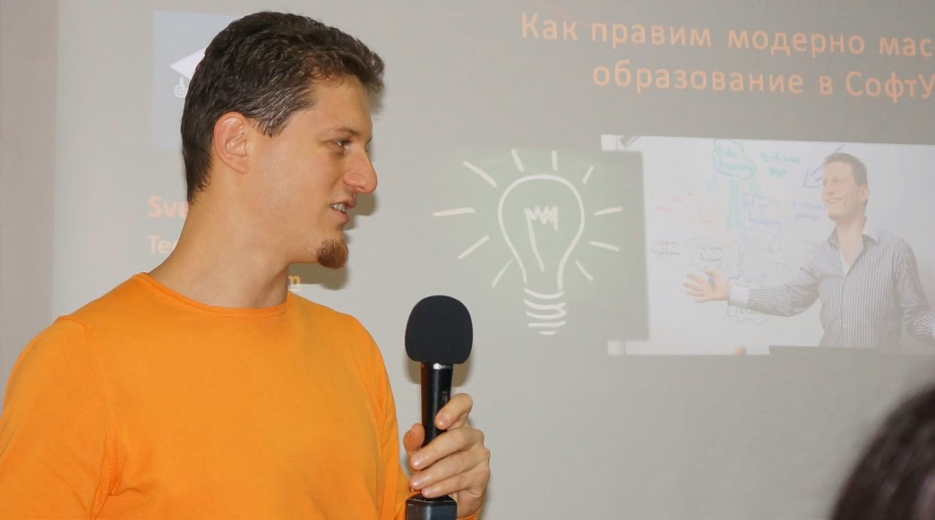
Training Duration – AngularJS
Lectures: ~ 14 hours (7 time * 2 hours)
Practical exercises (in class): ~ 14 hours (7 time * 2 hours)
Homework: ~ 10 hours
Schedule: Jun-Jul 2015

Slide 10

SPA with AngularJS Resources
http://angularjs.org/
http://docs.angularjs.org/api
https://github.com/jmcunningham/AngularJS-Learning
https://www.youtube.com/watch?v=i9MHigUZKEM
http://fastandfluid.com/publicdownloads/AngularJSIn60MinutesIsh_DanWahlin_May2013.pdf
https://github.com/SoftUni/SPA-with-AngularJS

Slide 11
AngularJS
http://VGeorgiev.org/

Slide 12
License
This course (slides, examples, demos, videos, homework, etc.) is licensed under the "Creative Commons Attribution-NonCommercial-ShareAlike 4.0 International" license
Attribution: this work may contain portions from
"SPA with AngularJS" course by Telerik Academy under CC-BY-NC-SA license

Slide 13





Free Trainings @ Software University
Software University Foundation – softuni.org
Software University – High-Quality Education, Profession and Job for Software Developers
softuni.bg
Software University @ Facebook
facebook.com/SoftwareUniversity
Software University @ YouTube
youtube.com/SoftwareUniversity
Software University Forums – forum.softuni.bg

